Slide 1
AI GPU Grid: Scalable GPU Interconnects with AXI/CHI & NoC
PROBLEM STATEMENT (HARDWARE) Exploration of architectural and protocol level innovations for GPU-to-GPU Communication

Slide 2
TEAM BLACK_MAGNET BITS GOA
YUGANDHAR PATIL AARUSH BHARGAVA
SWAPNIL YADAV

Slide 3
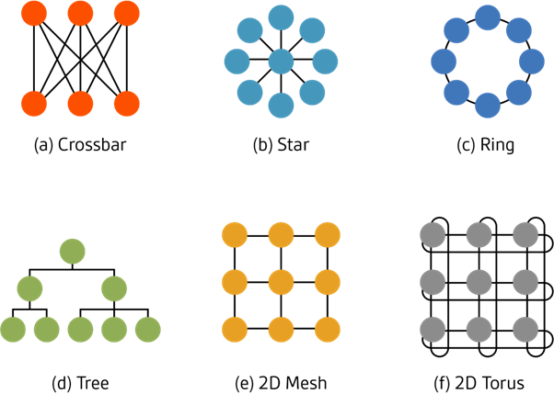
Introduction
Understanding the problem statement
GPU architecture
Different NOC topologies
Parameters
CHI/AXI protocols
Our approach-
What is the current status? Simulating the current model- act as our base. Improvements? – academic research. Our own ideas! Simulating the new version. Compare with the base model. Trade offs ?
Current models
Innovation
Better model
Credit-Arteris

Slide 4
Protocol Selection & Topology Analysis
AXI or CHI ? → Legacy / modern NOC’s →Scalability →QOS
→Coherency → Complexity →Flow control(handshaking) →FUN and Challenging
Survey of current models- NVLINK , Infinity Fabric NVIDIA Volta/Ampere/Hopper , AMD GPU-clusters , IBM Blue Gene
Results- 2D mesh (or hybrid mesh-based) NoC topologies are a dominant choice.
Sources- https://images.nvidia.com/content/volta-architecture/pdf/volta-architecture-whitepaper.pdf? - https://www.sciencedirect.com/science/article/abs/pii/S0065245821000759?

Slide 5
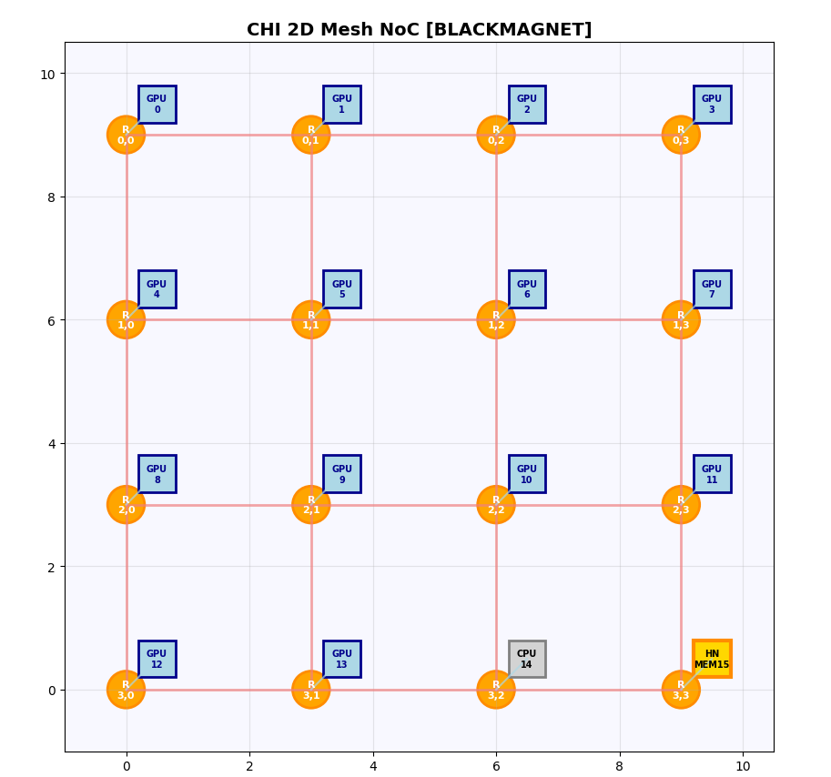
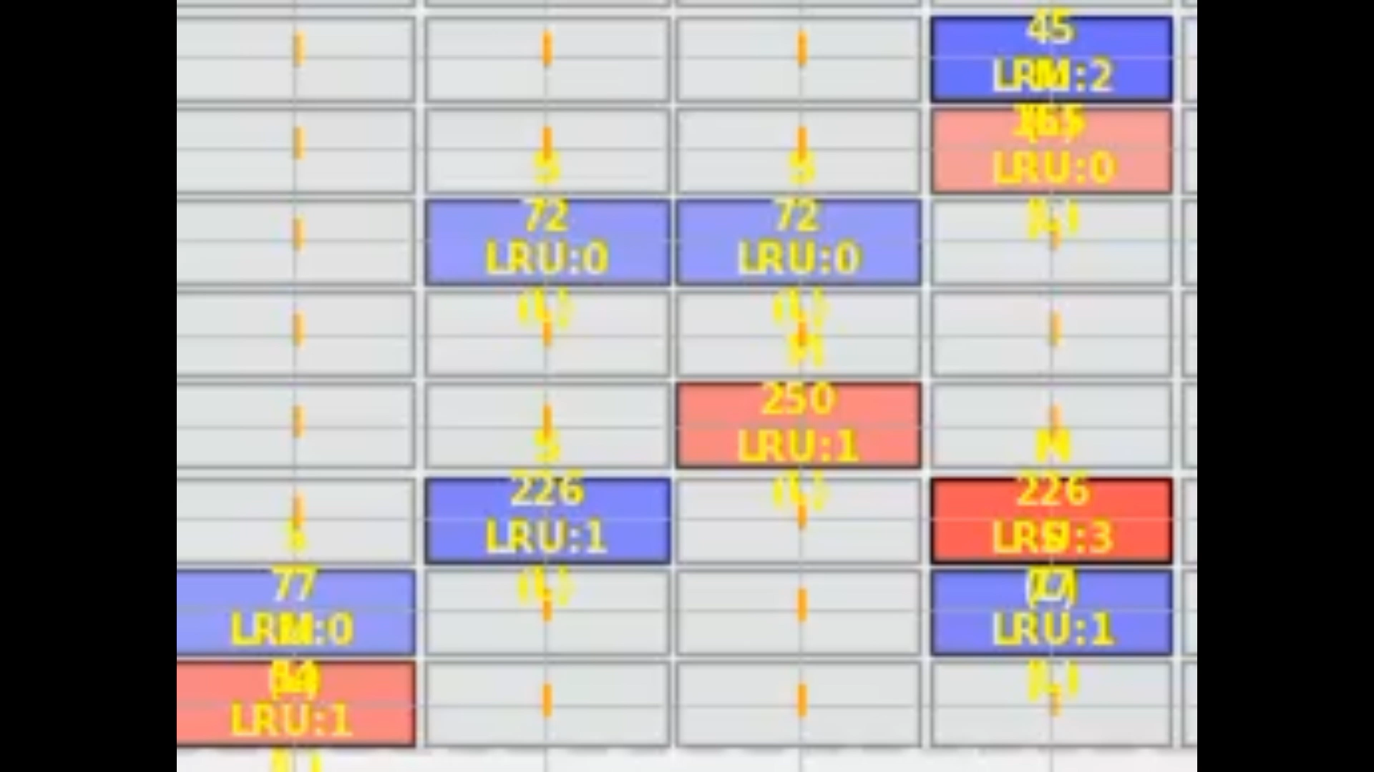
Implementing CHI for Mesh Topology Our base model
center
edge
▶ Home node placement ▶ Traffic generator ▶ Global memory ▶ Local cache ▶ LRU policy in local cache ▶ MESI states ▶ Modelling of delays ▶ Queuing ▶ Flits transaction extract ▶ Calculating parameters ▶ Difference in timeline: Visual GUI vs Backend
MEOSI
Cache hit | 2ns
Cache hit overhead | 0.5ns
GPU Cache miss | 30ns
G. Mem access | 100 ns
Switch process delay | 3ns
Final delivery decode | 3ns
Backbone link delay access link delay
Queuing | Dynamic

Slide 6
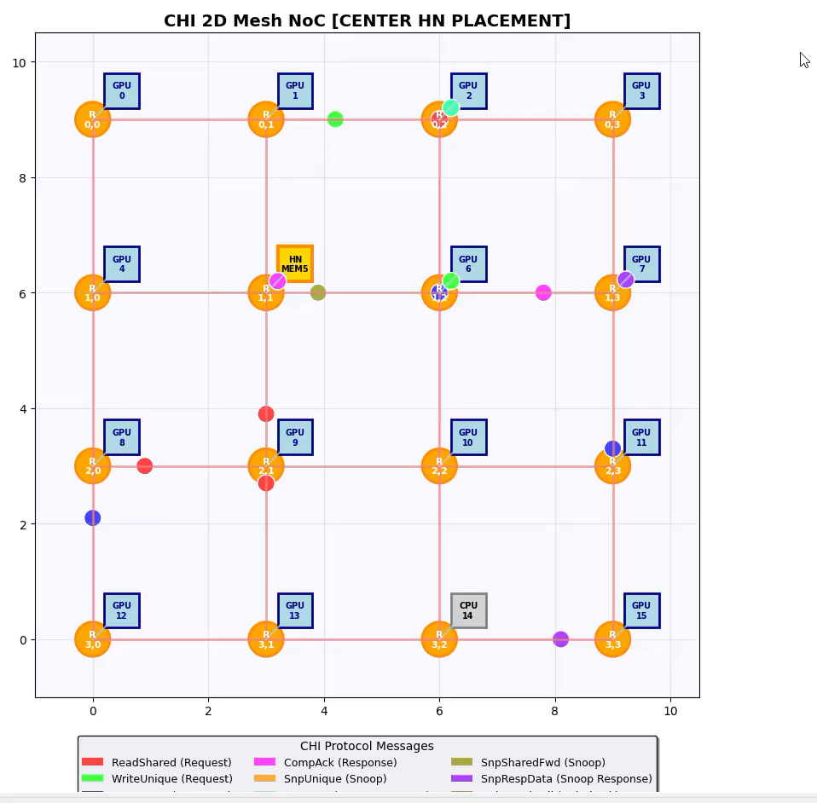
MESH- CHI SIMULATION

Slide 7
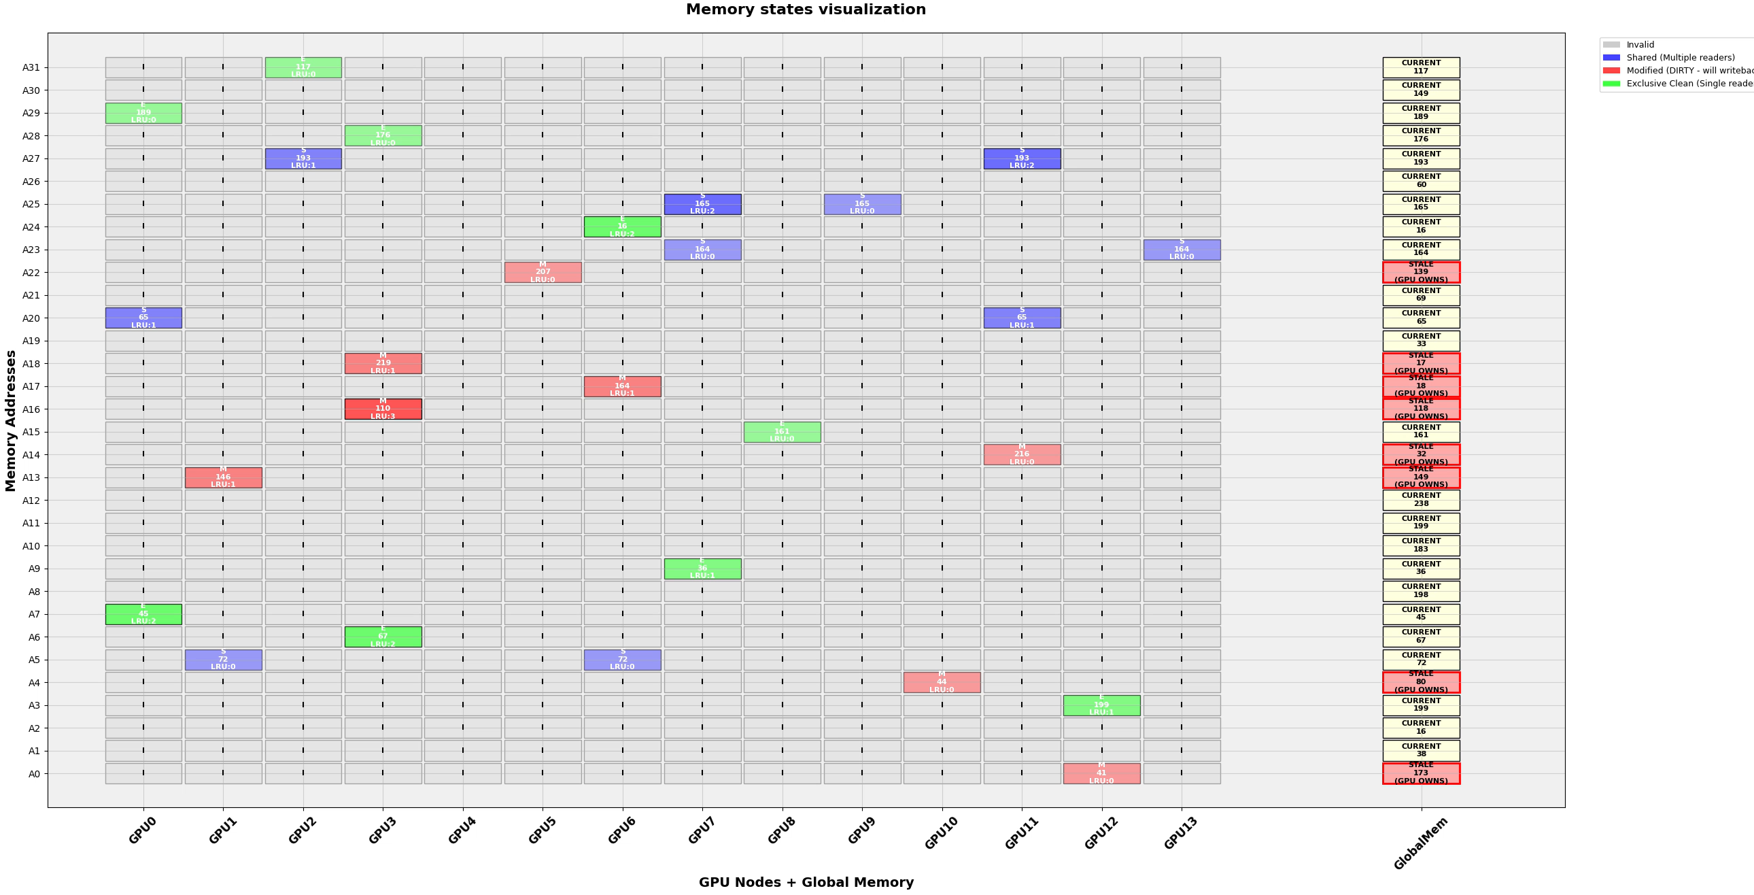

Slide 8
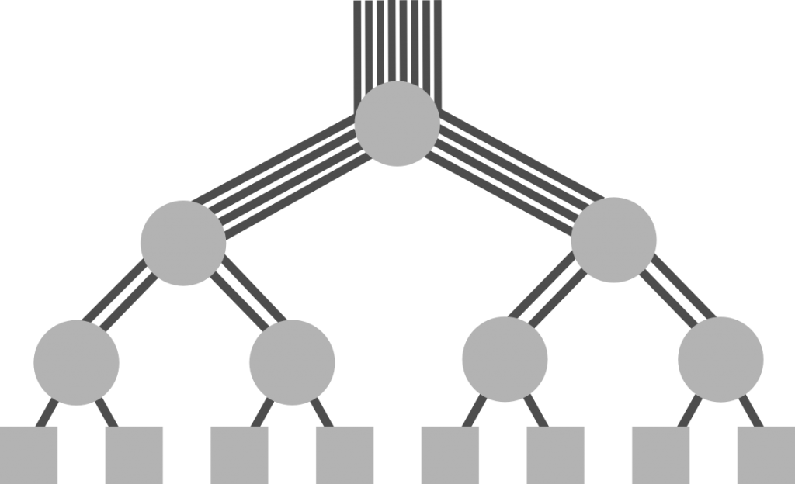
IMPROVEMENTS AND INNOVATION
Topologies – Fat-tree
Trade-off analysis – fat-tree & Mesh Latency bandwidth complexity resources- connections?
Scalability
https://clusterdesign.org/fat-trees/ https://surl.li/tycvkd https://www.ijstr.org/final-print/nov2019/A-Survey-Of-Fat-Tree-Network-On-Chip-Topology-.pdf

Slide 9
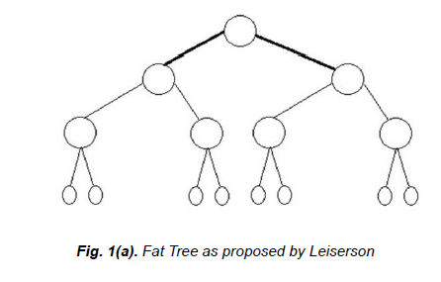
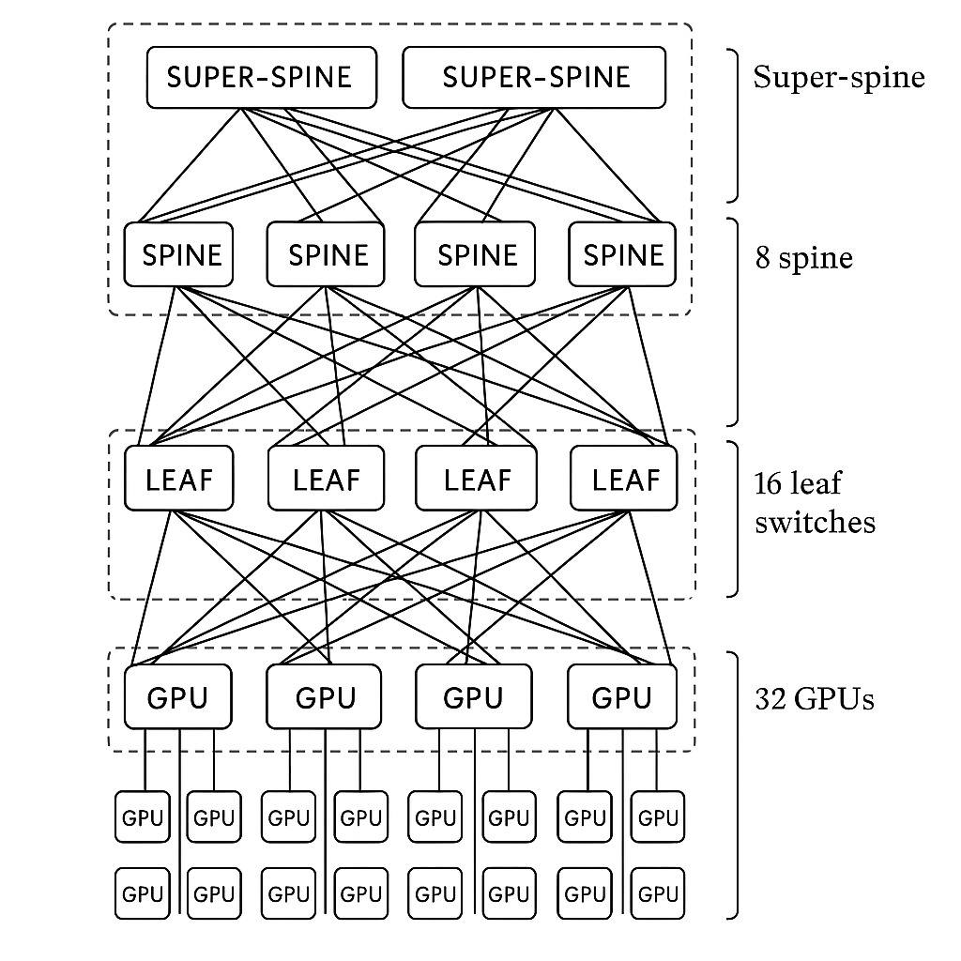
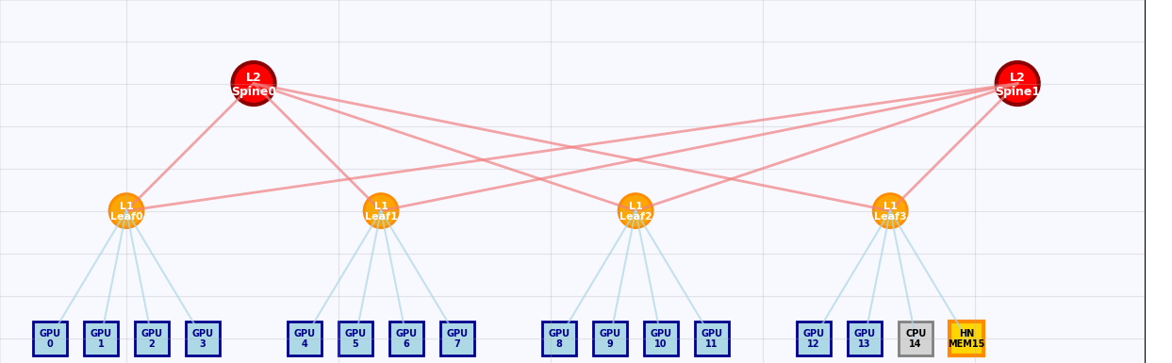

FAT-TREE IMPLIMENATATION
Normal Fat-tree as proposed by Leiserson
The modified fat-tree- Newer version!
Our Model - 16 IP BLOCKS – 2 level hierarchy
Delay modeling
Queuing etc.
Cache and Global memory

Slide 10
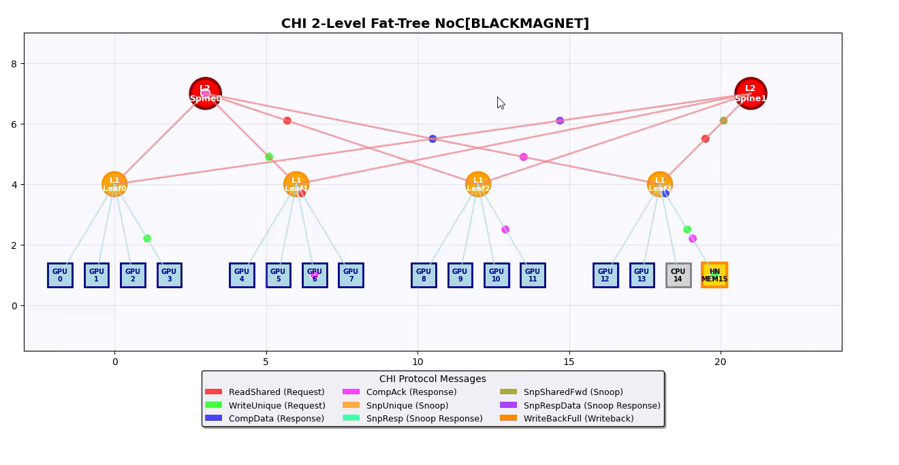
FAT TREE CHI MODEL IMPLIMENTATION

Slide 11
Performance Comparison 6000 Operations
Parameter | Fat-tree | Mesh | Result
Simulation time | 1.484 ms | 1.541 ms | 3.7% faster in FT
Latency(Avg) | 247.3 ns | 256.9 ns | 3.7% lower in FT
Through-put MB/s | 1015.5 | 977.5 | 3.9% higher in FT
Hop-count(Avg) | 4.707 | 5.254 | 10.4% fewer in FT
Network component | 6 | 16 | 62.5% lower in FT
Scalability | O(logN) | O(N) | Better in FT
Bandwidth | Constant | Dependent on nodes | ?
TRADE OFFS?
Result book and operation logs- ( https://drive.google.com/drive/folders/1nrafirXUFYPbajpLmqW2oBfQvxmt1Xev?usp=sharing )

Slide 12
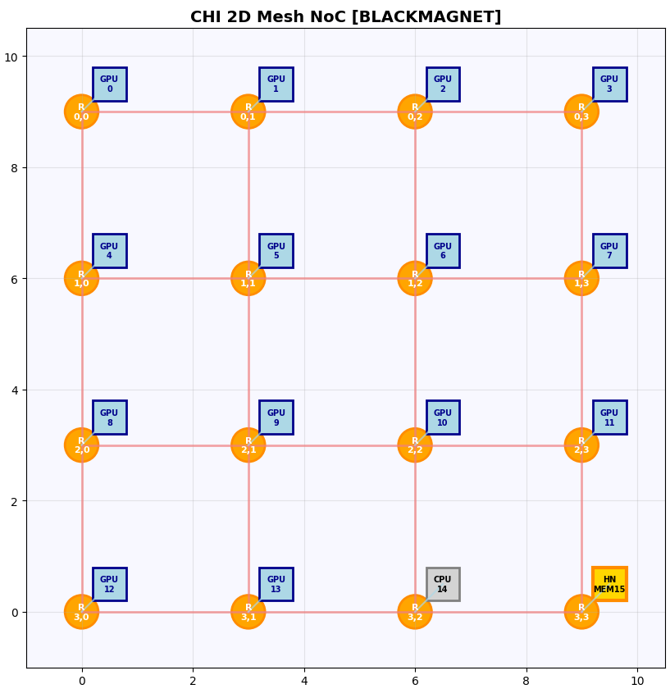
HOME NODE PLACEMENT IN MESH EDGE VS CENTER
6000 operation comparison- what we understood from this- Ability to process flits queuing
Parameter | Fat-tree | mesh | Mesh (center)
Simulation time | 1.484 ms | 1.541 ms | 1.46 ms
Latency(Avg) | 247.3 ns | 256.9 ns | 243 ns
Through-put MB/s | 1015.5 | 977.5 | 1032.54
Hop-count(Avg) | 4.707 | 5.254 | 4.184
Network component | 6 | 16 | 16
Scalability | O(log N) | O(N) | O(N)
Bandwidth | Constant | Dependent on nodes | Dependent on nodes

Slide 13
Further Exploration and Innovation
FIFO LRU SAME?
What can we do to improve the performance?
Better replacement algorithms- showed negligible to no improvement- WHY?
CHI Protocol Aggregation- Combine multiple small transactions
A) Cache Line Transfers B) Write Data Aggregation C) Acknowledgement/Invalidation bundling
3.Acknowledgment Message Priority- Make RN free as fast as possible (again no improvement)
BAD IDEA ?
Violates atomicity requirements
Increases complexity without proportional benefits
Cache coherence protocol dependencies
4. Something is wrong with our simulation?!!
New protocol or think of something else

Slide 14
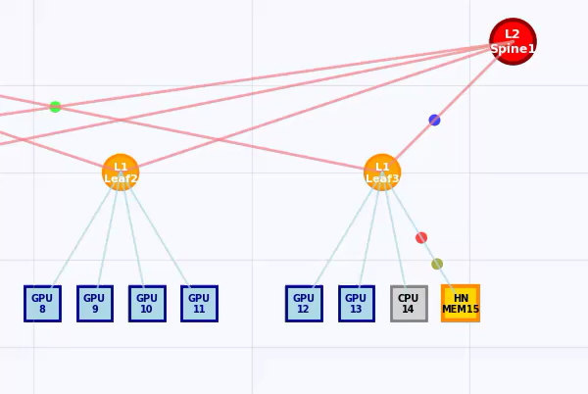
Notice the traffic at L1-leaf3- HN(global memory) node! – VERY HEAVY
OBVIOUS!@
Global memory access out of 6000 operations- 5220!!! (87%) WHY? – PROTOCOL - MISS RATE?
BACK TO THE QUESTION?
is Something wrong? - what’s the use of cache if such high miss rate?
-Practical NOC’s and SOC’s Shader engines, Volta GPU – specialized GPCs

Slide 15
Making of More Realistic Model
Problems with our model- Random Traffic Generator: No locality patterns No Spatial Relationship No specialized Clusters Single home node bottleneck
IDEA!!@@

Slide 16
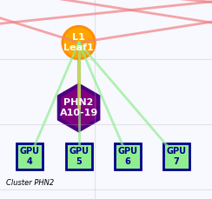
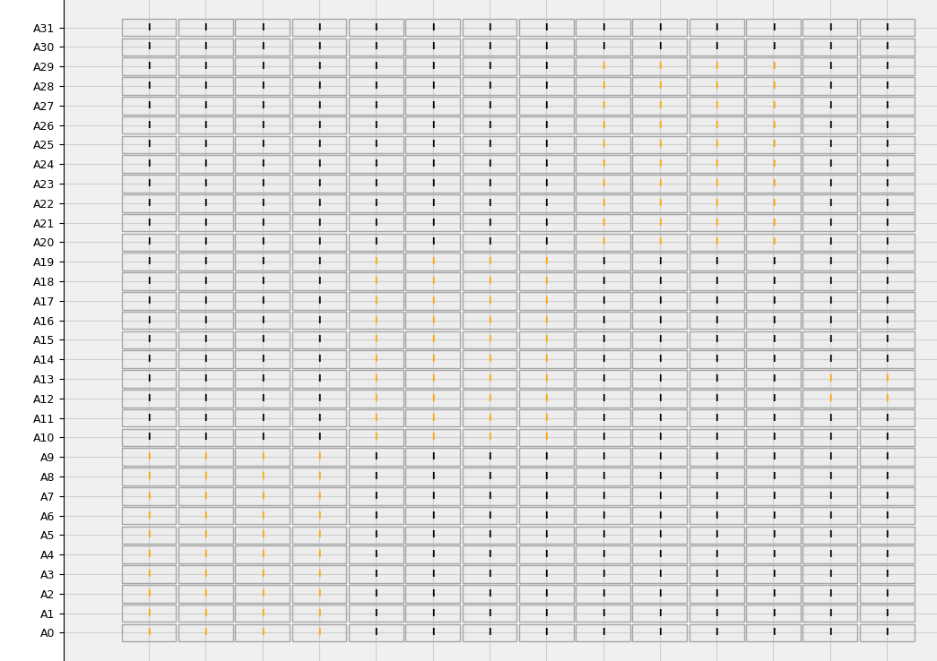
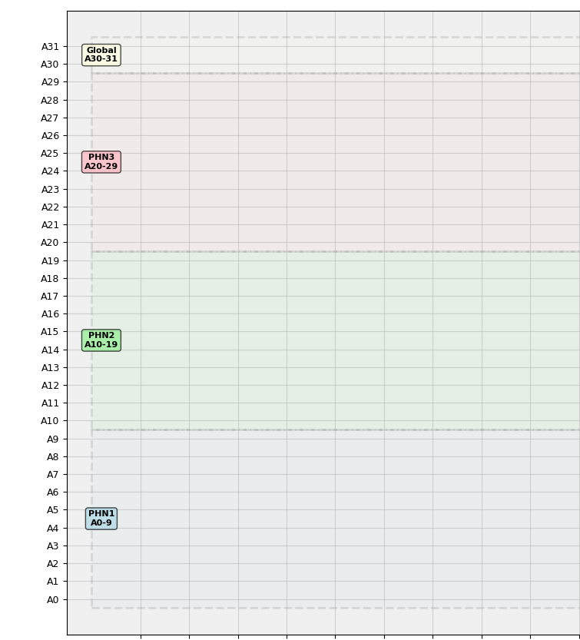
Our Noval Innovation - Partial Home Node (PHN) Architecture
PHN- what is it? -Architecture
- subset of address space
- like a cache level but with specific preference of memory - acts as a home node for its leaf - To maintain coherency with Global Home node ?
Exclusive
PHN3- say shader cluster
PHN2- say tensor cluster
PHN1- say Pixel RT solver

Slide 17
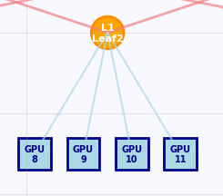
WHAT CHANGES?
Almost everything
Protocol change- our new modified CHI protocol
MEOSI to MOSIUUP- New states added by us and Exclusive clean removed
Cluster Organization: G1, G2, G3, G’ { G1 Cluster: GPUs 0-3, addresses 0-9 (PHN1) G2 Cluster: GPUs 4-7, addresses 10-19 (PHN2)
G3 Cluster: GPUs 8-11, addresses 20-29 (PHN3)
G' Cluster: GPUs 12-13, addresses 30-31 (Global HN)}
Priority Setting- { Local Priority: Cluster-local accesses preferred Cross-Cluster: Lower priority, higher latency Global Coordination: G' cluster manages coherence}
Enhanced Traffic Generator 95%-5% { 95% Local Traffic: Access within same cluster
5% Cross-Cluster: Access to outside cluster}
{Also tried 85%-15%}
FAT TREE PROVIDES INBULIT CLUSTER ARRANGEMENT
G1_m

Slide 18
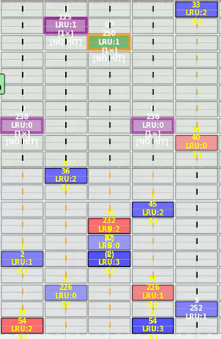
Modified Communication Protocol
newly added CHI messages- - PHNRead
- PHNInvalidate - PHNWrite
- Dual Write
Global Home node
Similar
RN
Leaf switch
Partial Home node
New states- 1. Used state (U) → why needed at all? • Purpose: Cross-cluster read data • Behavior: Cannot satisfy future cache hits • Lifetime: Single use, then becomes invalid
2. Updated (UP) • Purpose: Cross-cluster write data • Behavior: One-time write, then invalidated • Coherence: Triggers global memory update

Slide 19
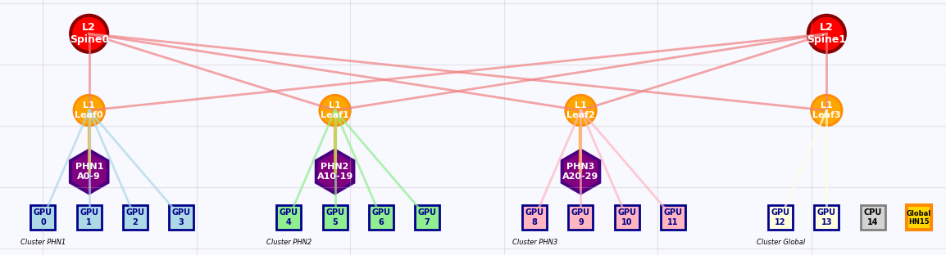
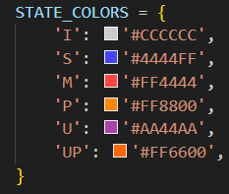
Highest Priority cluster connected directly to global home node
PHN CACHE ACCESS TIME = 60 ns in between global memory access time (100 ns) and GPU own cache miss= 30ns

Slide 20
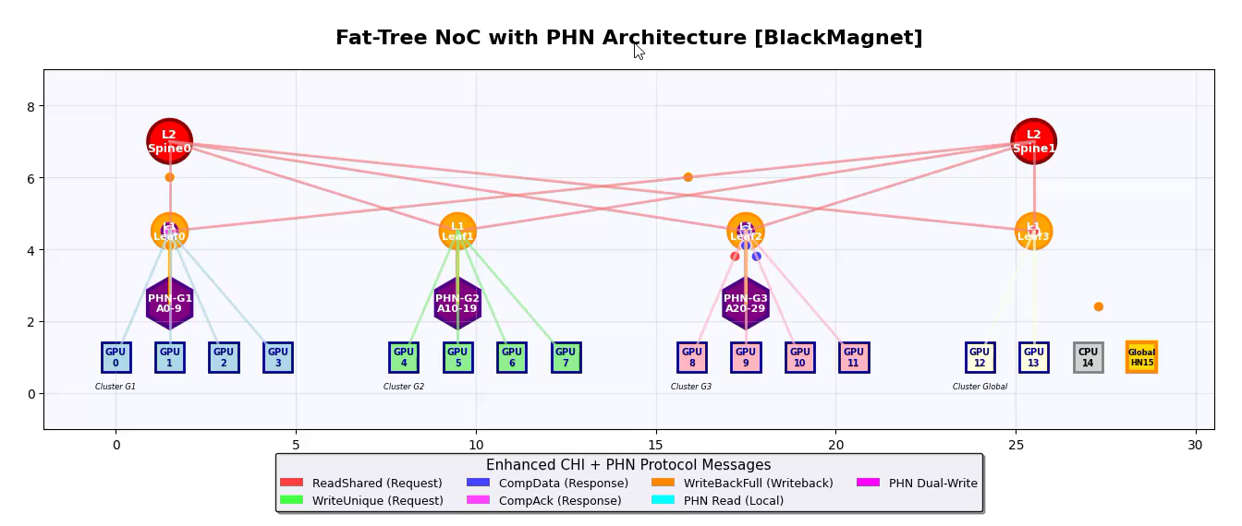
Fat-Tree- Partial Home Node model

Slide 21
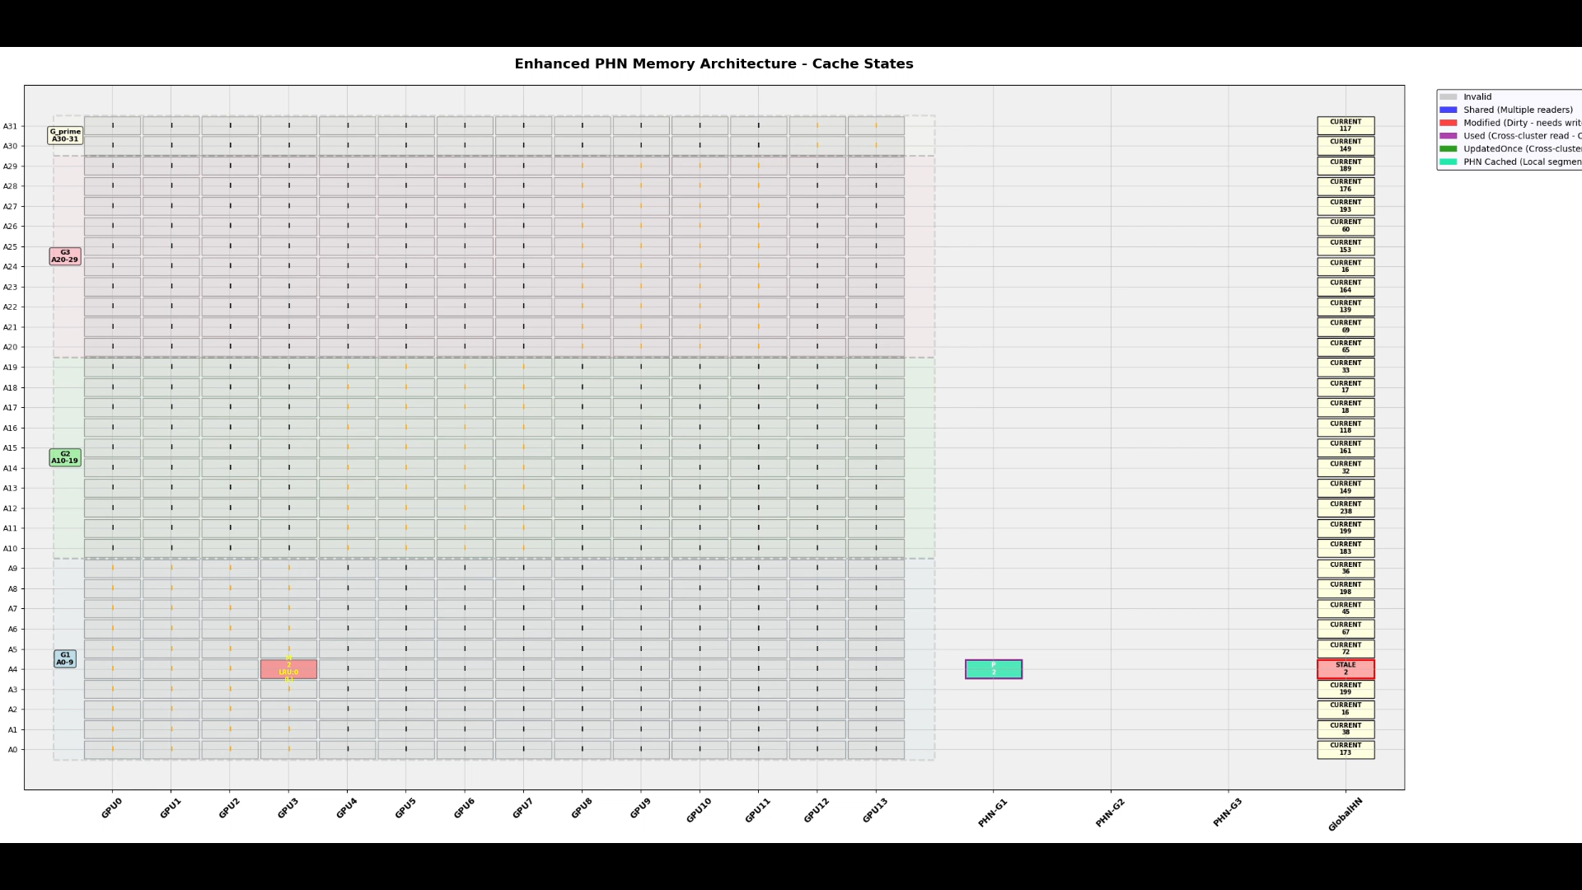
Enhanced Simulation - Compulsory Misses in the beginning
First Access: Always miss, unavoidable

Slide 22
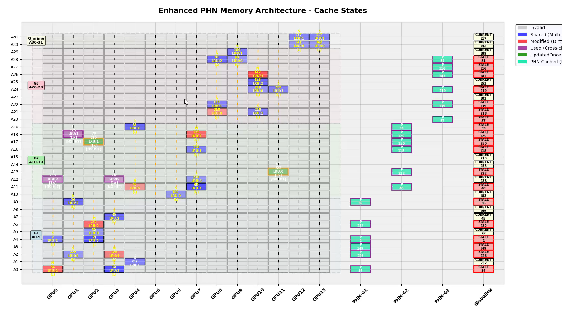
After Initial stages-

Slide 23
Performance Improvements & Trade-offs
Parameter | Fat-tree | mesh | Mesh (center) | PHN fat-tree OUR NEW MODEL
Simulation time | 1.484 ms | 1.541 ms | 1.46 ms | 0.94ms
Latency(Avg) | 247.3 ns | 256.9 ns | 243 ns | 180.3 ns
Through-put MB/s | 1015.5 | 977.5 | 1012.48 | 1761.21
Hop-count(Avg) | 4.707 | 5.254 | 4.184 | 3.49
Network component | 6 | 16 | 16 | 6
Scalability | O(log N) | O(N) | O(N) | O(log N)
Bandwidth | Constant | Dependent on nodes | Dependent on nodes | Constant
TRADE OFFS ?
HYBRID RING?
Result book and operation logs- ( https://drive.google.com/drive/folders/1nrafirXUFYPbajpLmqW2oBfQvxmt1Xev?usp=sharing )

Slide 24
Summary of the innovation exploration-
Home node placement effects
Replacement algorithms
CHI protocol aggregation
Message priority
PHN model in fat tree
- CHI Modification - STATE modifications - Solves Global memory access bottleneck

Slide 25
LIVE DEMO

Slide 26
THANK YOU Open to questions-
Team BLACK_MAGNET

Slide 27
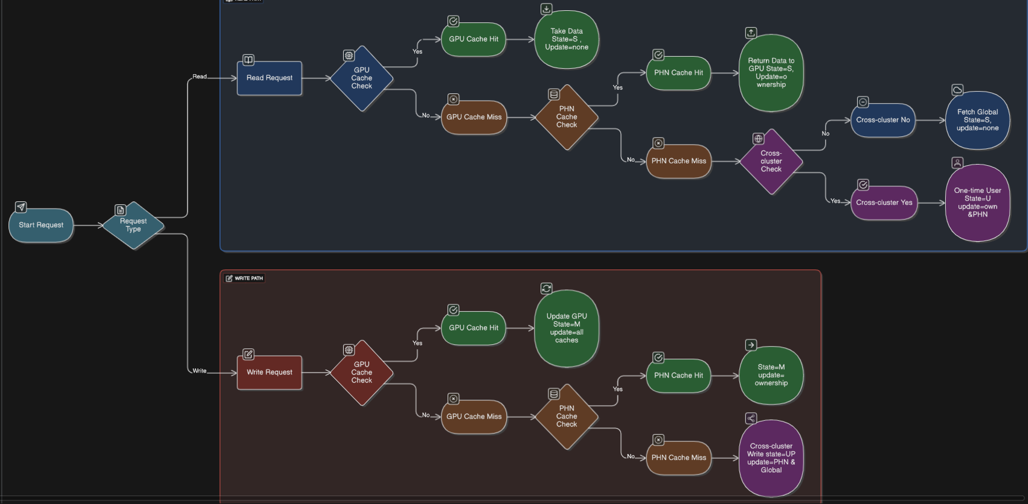

Slide 28
Functions- _get_access_link_delay() = (PACKET_SIZE*8)/ACCSS_LINK_BW
_get_backbone_link_delay() = (PACKET_SIZE*8)/BACKBONE_LINK_BW #access link bandwidth= 200 Gbps # backbone link bandwidth =400 Gbps
#Packet size= 64 byte = 512 bits. access delay = 512 / 200e9 = 2.56 ns backbone delay = 512 / 400e9 = 1.28 ns
Basic fat-tree + PHN 1) Same-leaf (source → leaf → switch processing → leaf out → access) access + switch + access = 2.56e-9 + 3.0e-9 + 2.56e-9 = 8.12ns 2)Cross-leaf (source → leaf → leaf->spine link → spine→leaf → leaf_out → access) access + (switch + backbone) + (switch + backbone) + switch + access
= 2.56e-9 + (3e-9 + 1.28e-9) + (3e-9 + 1.28e-9) + 3e-9 + 2.56e-9 = 16.68ns if PHN hit → 8.12+60= 68.12 ns, normally without PHN → 8.12 + link access (depends) + 100ns = around 112 ns
Throughput (MB/s)=Total Messages×Packet Size (bytes) Simulation Time (seconds)×10^6

